Slide 1
Serious Games: Introduction
Dr. Rob Seater
July 2021
Notes:
1
1
Check distro statement before using:
DISTRIBUTION STATEMENT A. Approved for pubic release: distribution is unlimited.
This material is based upon work supported under Air Force Contract No. FA8721-05-C-0002 and/or FA8702-15-D-0001. Any opinions, findings, conclusions or recommendations expressed in this material are those of the author(s) and do not necessarily reflect the views of the U.S. Air Force.
© 2021 Massachusetts Institute of Technology.
Delivered to the U.S. Government with Unlimited Rights, as defined in DFARS Part 252.227-7013 or 7014 (Feb 2014). Notwithstanding any copyright notice, U.S. Government rights in this work are defined by DFARS 252.227-7013 or DFARS 252.227-7014 as detailed above. Use of this work other than as specifically authorized by the U.S. Government may violate any copyrights that exist in this work.

Slide 2
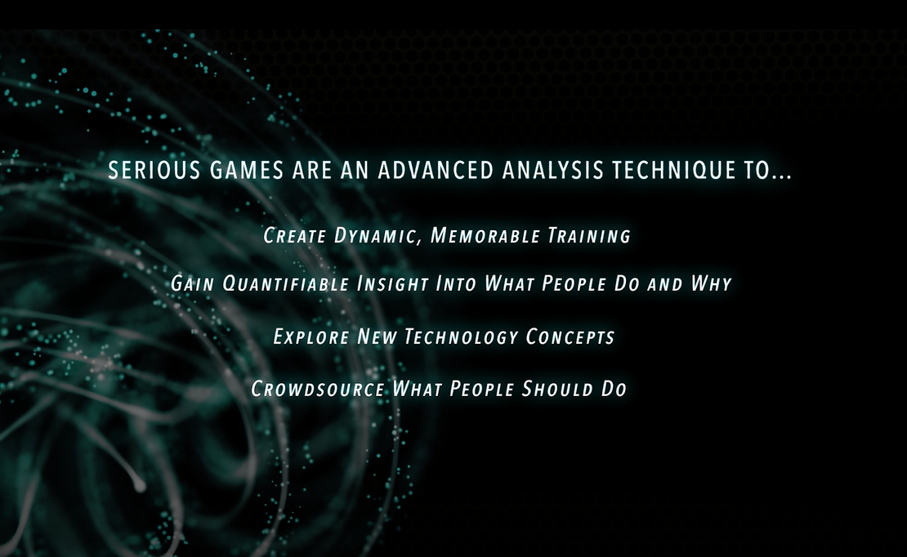
Serious Games are a Thing: Video

Slide 3
Outline
Theory
Example
Tradeoffs
Definitions
Notes:
Human brains use prototype based categories and family-resemblance based categories, not rule-base categories, even though that’s not how we think we think. There’s a whole bunch of studies on that in psychology, but suffice to say: If you’re learning something, it’s best to start with examples. If you’re doing science, you need definitions. So, I started with examples, and now I’ll give some definitions.

Slide 4
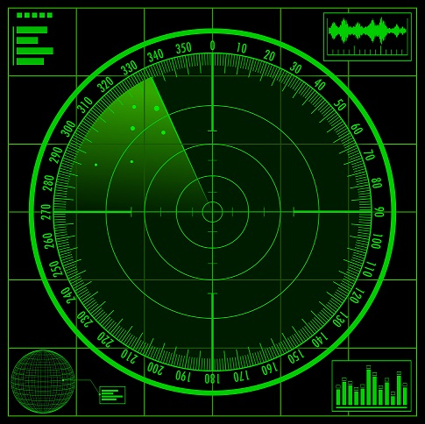
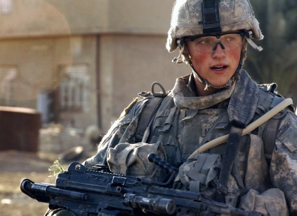

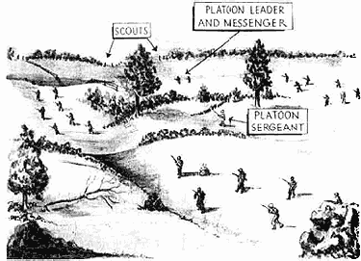
Analyzing User-Facing Future Technology is Hard
Requirements Unknown
Operators & Experts Bad at Theorizing
Everyone Is a Novice User
Doctrine & Tactics Change
…and the whole analysis might reset when the adversary adapts.

Slide 5


Rapid-Play Serious Games
Short
Accessible
Flexible
1-2 minute turns
10-15 minute games
1-2 hour session
Minutes to hours
Focused domain slice
No special equipment
Play remotely
Easy to generate scenarios
Easy to modify objectives
many plays
x
many participants
x
many scenarios
Images = icons created at LL

Slide 6
Analyzing User-Facing Future Technology is Hard
Requirements Unknown
Operators & Experts Bad at Theorizing
Everyone Is a Novice User
Doctrine & Tactics Change
…and the whole analysis might reset when the adversary adapts.

Slide 7


Technology Development Lifecycle
Concept Definition and Requirements Trades
Prototyping and Development
Testing, Validation, and Employment strategy
Deployment, Trust, and Training
?
Neglecting the human element at each stage of technology development can reduce adoption
Notes:
Discuss 10x rule for cost of correcting an error
Discuss difficulty of tacking a problem early --
Anecdote of failure at field test when easily catchable early
Failure modes: too little triage, too much triage, forget to review with end user

Slide 8
Technology Development Lifecycle
Concept Definition and Requirements Trades
Prototyping and Development
Testing, Validation, and Employment strategy
Deployment, Trust, and Training
Conduct rapid wargaming and concept prototyping
Evaluate technology investments and tradeoffs
See and experience earlier prototypes and offer feedback
Determine and prepare for relevant field tests
Customize decision aids to warfighter needs
Develop tactics, techniques, and procedures
Access and adapt content, learn by doing, and iterate often
Provide operational feedback throughout development
Using common methods and frameworks supports lesson sharing between stages
Interactive testbeds balance strengths of wargaming and modeling & simulation early in process
Notes:
Balance between wargames and mod-sim
Make it easier to include end user than make excused to skip it
Explore requirements + con-ops / enable intuition + creativity by red and blue

Slide 9
Outline
Theory
Example
Tradeoffs
Definitions
Notes:
Human brains use prototype based categories and family-resemblance based categories, not rule-base categories, even though that’s not how we think we think. There’s a whole bunch of studies on that in psychology, but suffice to say: If you’re learning something, it’s best to start with examples. If you’re doing science, you need definitions. So, I started with examples, and now I’ll give some definitions.

Slide 10
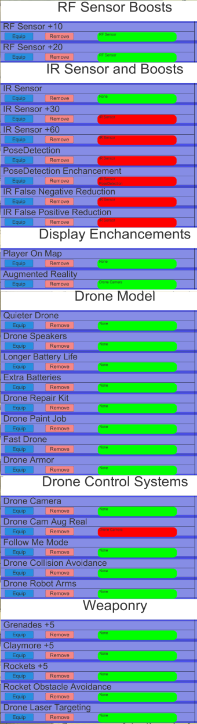
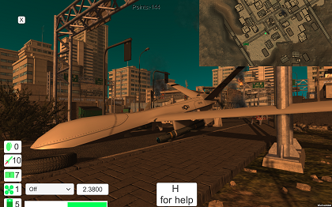
Case Study: UAV Integration into Infantry Squads
≈10 minutes
per full cycle
Mission: find downed predator drone in urban environment,
retrieve data, destroy predator, extract safely
Capabilities: personal UAV sensors, control/flight systems,
battery, targeting support, intelligent behaviors
Research Question: Which capabilities or combinations of capabilities are most valuable to this mission, and how do they alter tactics and doctrine?
Image source: LL screenshot

Slide 11
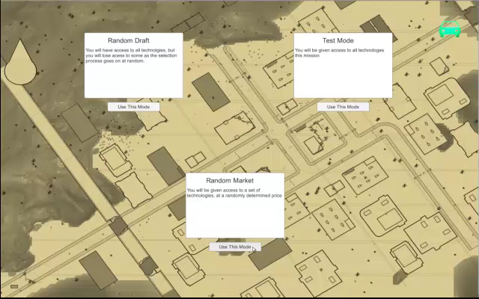
Demo Video

Slide 12
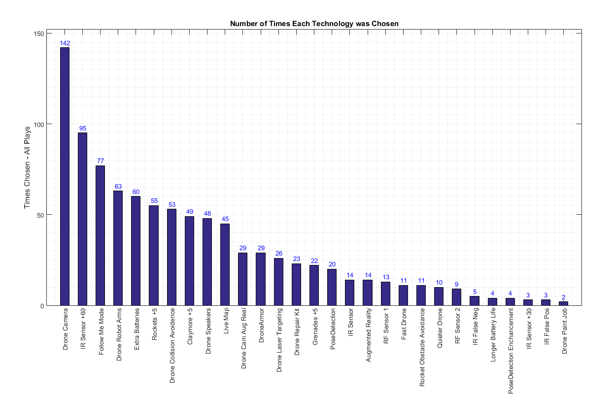
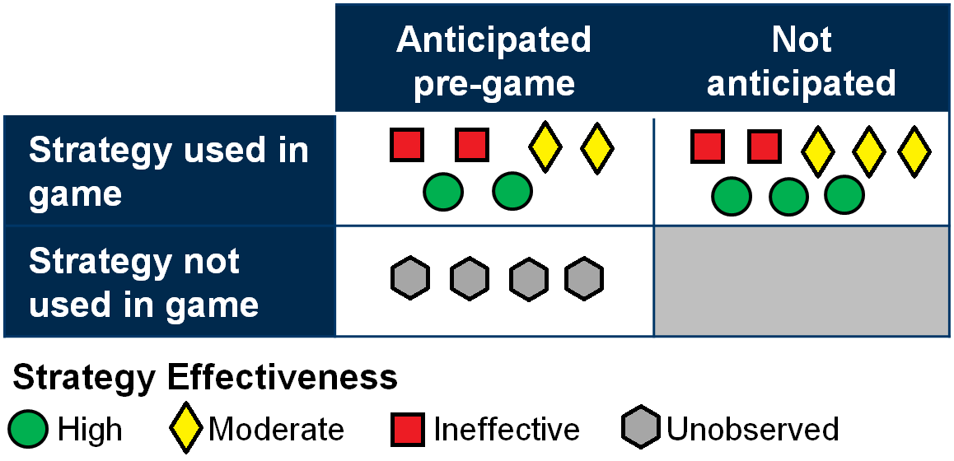
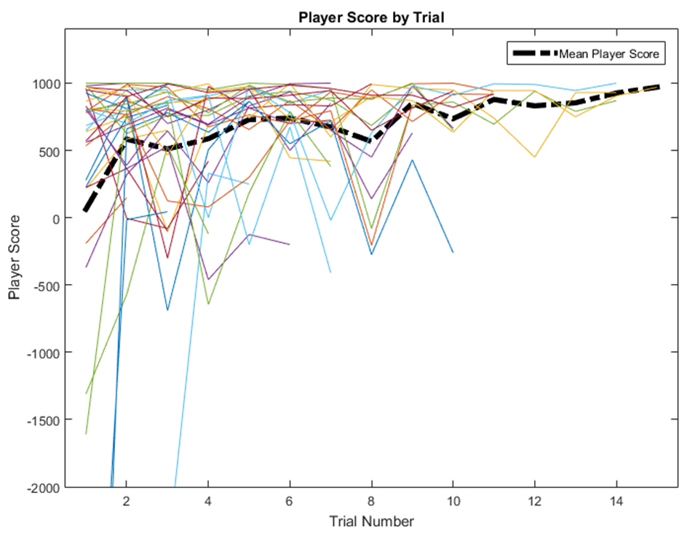
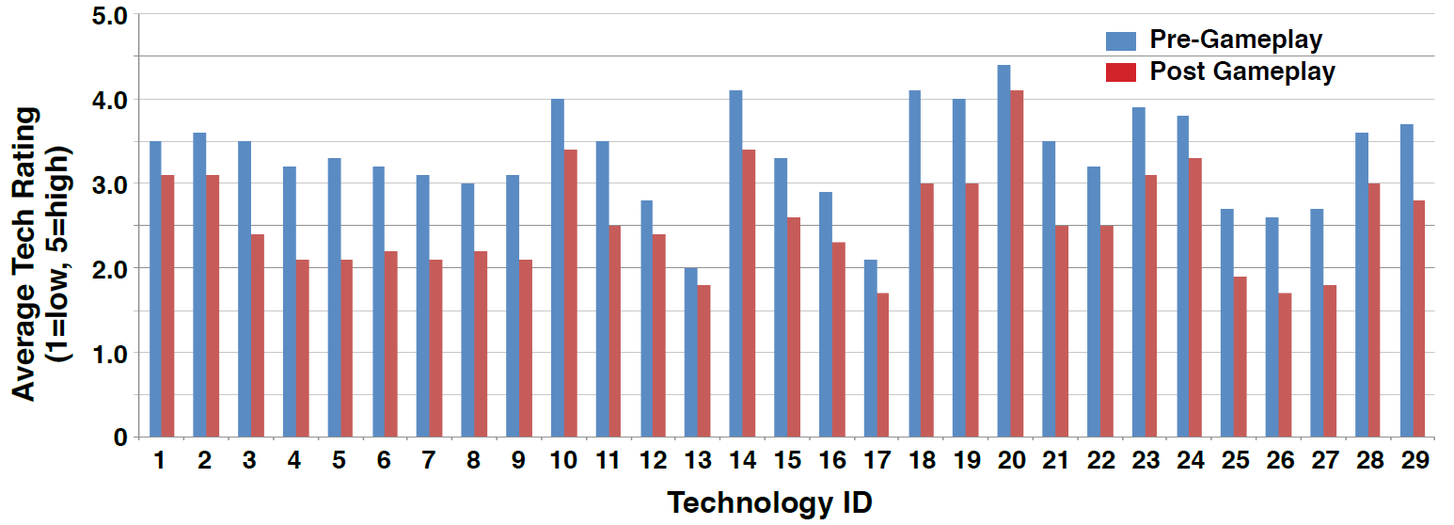
Sample Quantitative & Qualitative Metrics
Player technology selection prioritization and correlation with mission success
Unanticipated, effective strategies
Impact of gameplay on player ratings of capability value; players become more critical
Player performance and prioritization converge after a small number of repetitions.

Slide 13
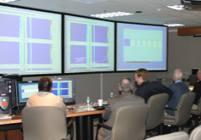
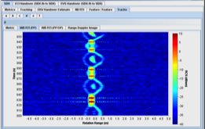
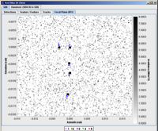
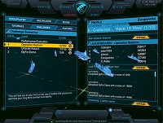
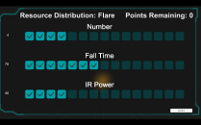
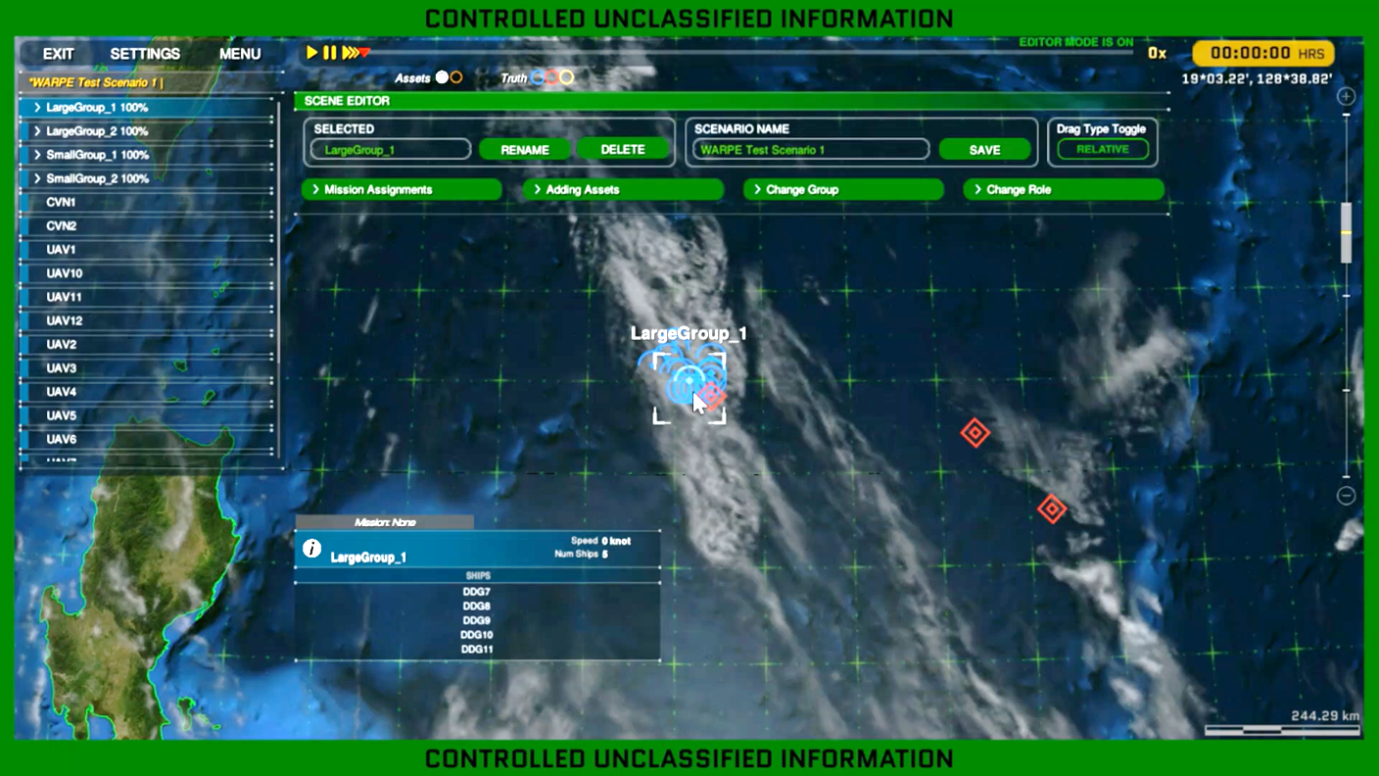
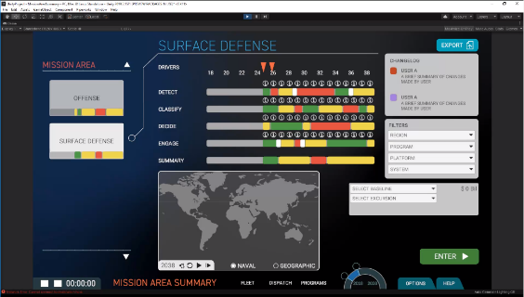
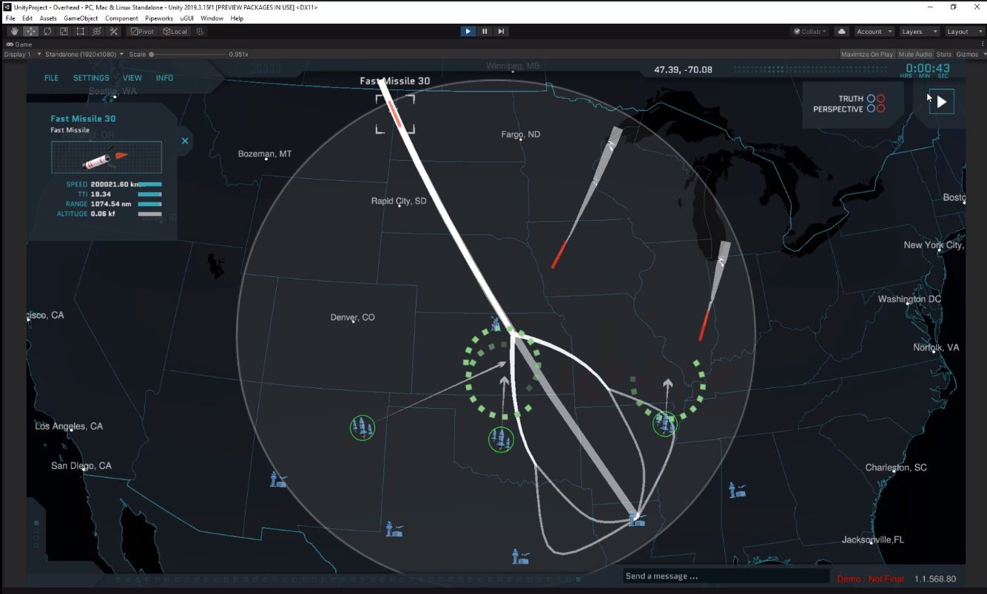
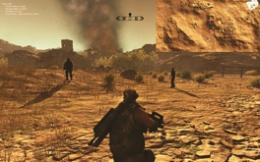
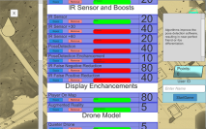
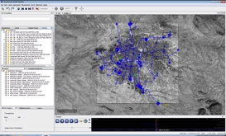
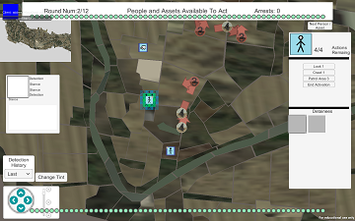
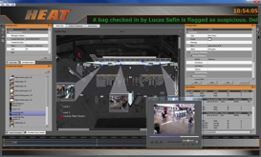
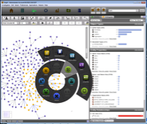
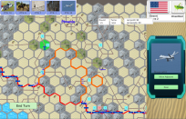
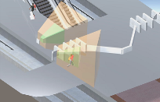
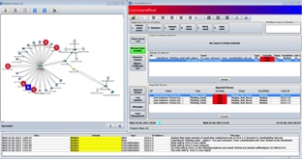
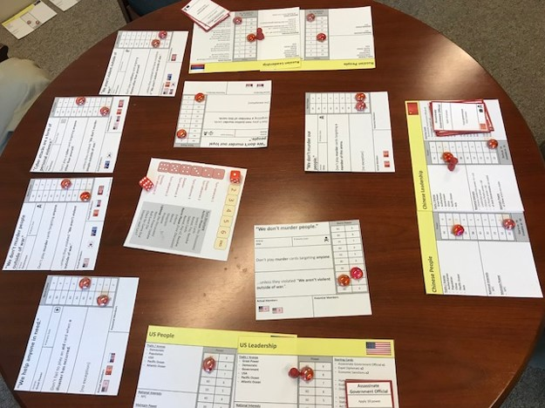
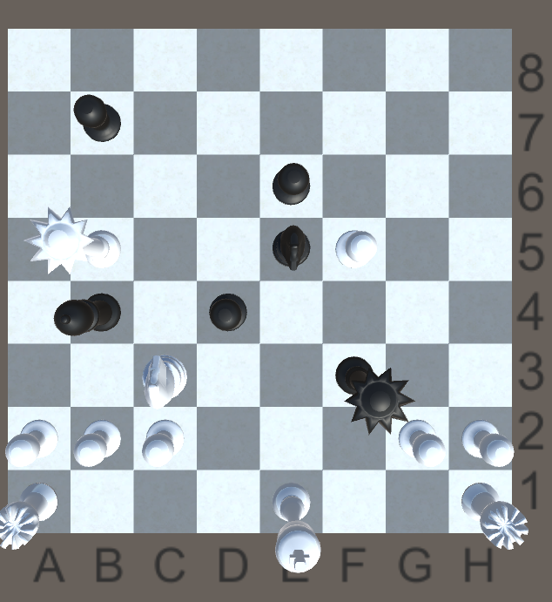
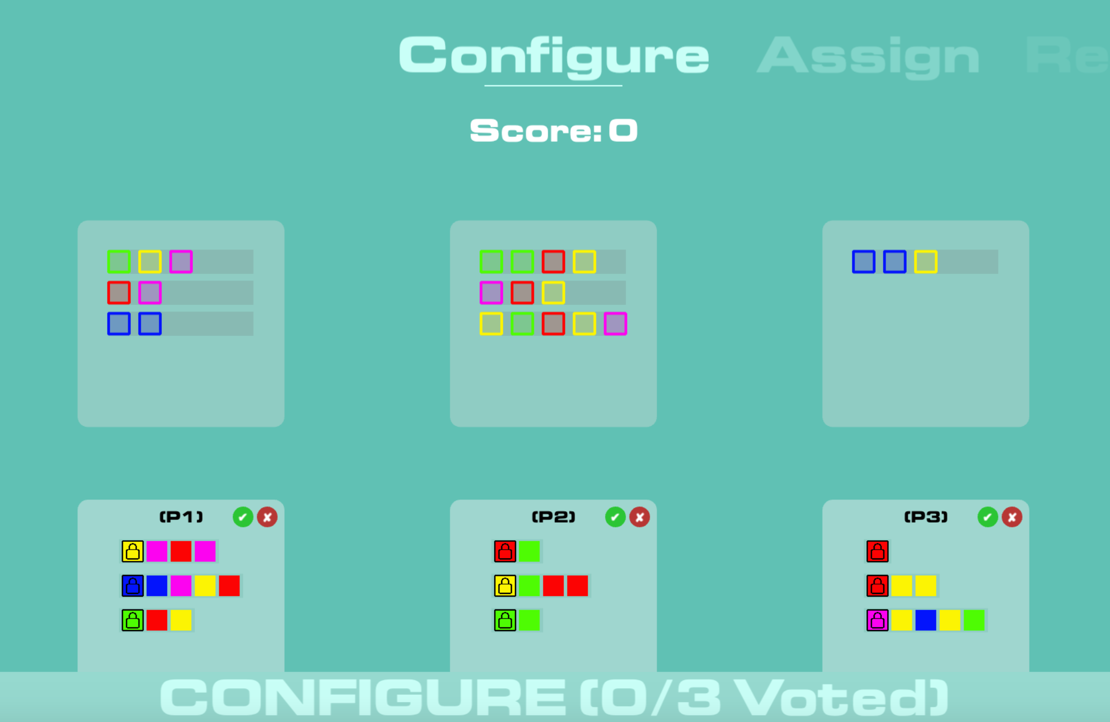
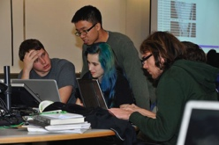
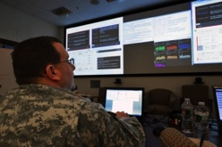
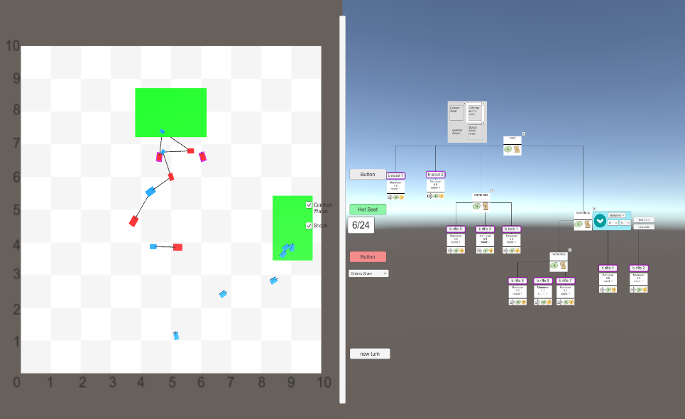
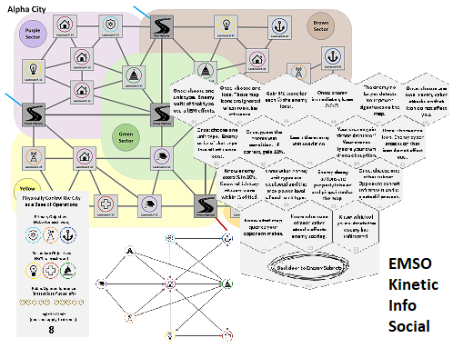
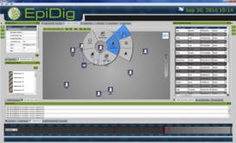
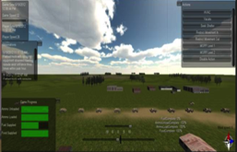
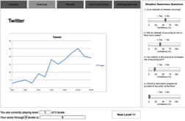
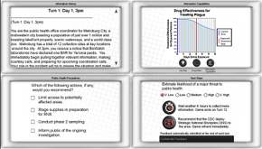
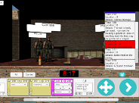
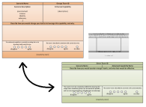
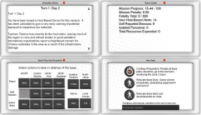
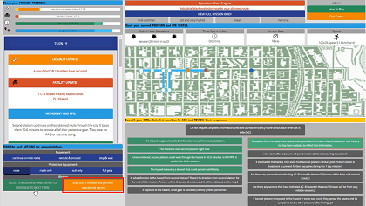
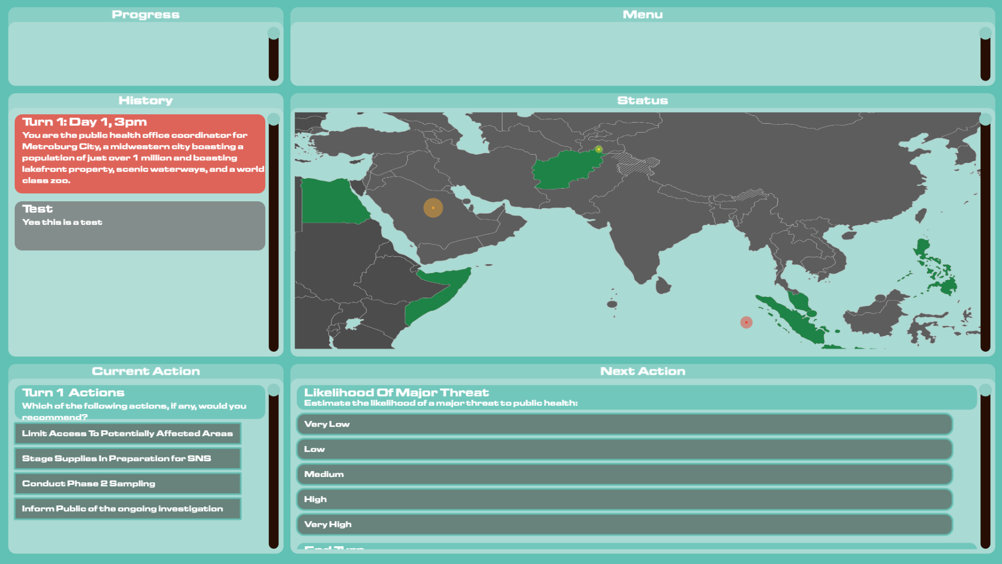
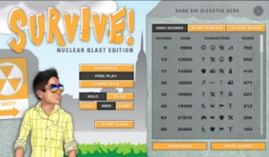
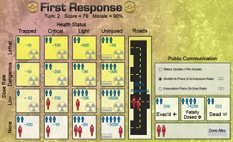
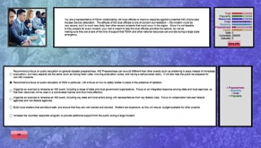
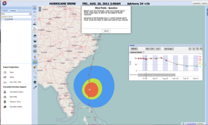
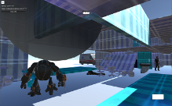
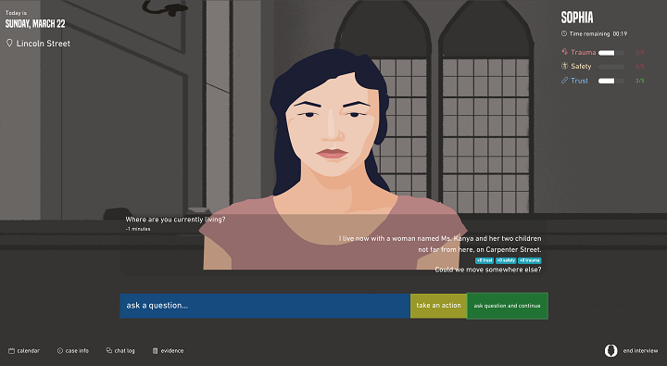




MIT LL History of Games Development
2001
2009
2010
2011
2012
2013
2014
2015
2016
2017
2018
2019
2020
2021
Missile Defense
ISR & Intelligence
Cyber Operations & Grayzone Warfare
Chem-Bio Defense & Bio-Tech
Emergency Management
Air Traffic Management & Logistics
Image source: LL screenshots

Slide 14



Defense Applications Rapid Play Games Informing Conventional Analysis
Infantry Squad Tactics Using Small UAVs
Naval Fleet Composition
Drone-Based Aerial Refueling
ISR Team Workflows & Tool Suites
Image Source: LL Screenshots

Slide 15




Non-DoD Applications Rapid Play Games Informing Conventional Analysis
Naval Missile Defense
Robotic Support for First Responders
Public Health Response to Bio-Terrorism
Large Scale Strategy for Drug Smuggling Interdiction
Standoff Security for Transportation Hubs
Image Source: LL Screenshots

Slide 16












Serious Game Experimentation Purposes
Instruction
Analysis
Discovery
Model Validation
Expert Decision Analysis
Crowdsourced Discovery of Enabled Tactics
Expert Review of Decision Space
Experiential Learning
Integrated Human-Machine Performance
Requirements Prediction & Estimation
Model Expressiveness (Red and Blue)
Personalized Instruction
Machine Learning from Human Experts
Impact of Future Technology
Guided Brainstorming (Red and Blue)
Factor Analysis for Scenario Generation
Other applications of serious games in the broader community include
Scenario Analysis, Social Influence, and Therapy.
Image source: stock photos purchased from shutterstock & LL screenshots

Slide 17
Rapid-Play Serious Games
A game is a sensor
for measuring human decision making.
A game is a system analysis tool
for studying systems complicated by humans.
A game is a medium of communication
between domain experts and technology experts.

Slide 18
Outline
Theory
Example
Tradeoffs
Definitions
Notes:
Human brains use prototype based categories and family-resemblance based categories, not rule-base categories, even though that’s not how we think we think. There’s a whole bunch of studies on that in psychology, but suffice to say: If you’re learning something, it’s best to start with examples. If you’re doing science, you need definitions. So, I started with examples, and now I’ll give some definitions.

Slide 19
Complementary Role
Very Predictable System
Low Complexity Environment
High Complexity Environment
Poorly Understood System
Notes:
Drone example
Bottom = what problems current exist in urban operations
right = political impacts
Top = flight control software under turbulence
Left = optimal routing to scan a city block
Middle = tactics for employing in a team in a city

Slide 20
Complementary Role
Very Predictable System
Sweet Spot
State space too large to optimize but not too larger to characterize key factors
System loose enough to permit innovation and creativity but not loose as to prevent modeling a feedback loop
Complement other methods (before or after)
Statistical Experimentation
(Instrumented HITL Experiments,
Agent Models, Stochastic Methods)
Historical Analysis
(Field Data, Natural Experiments, Detailed Planning Tools)
Optimization
(Game Theory, Machine Learning, Integer Programming)
Rapid Play Serious Games
and Interactive Testbeds
Low Complexity Environment
High Complexity Environment
Expert Input
(Discussion-Based Wargames, Scenario Walkthroughs,
Interviews, Talk Aloud Observation)
Poorly Understood System
Notes:
Drone example
Bottom = what problems current exist in urban operations
right = political impacts
Top = flight control software under turbulence
Left = optimal routing to scan a city block
Middle = tactics for employing in a team in a city

Slide 21
Outline
Theory
Example
Tradeoffs
Definitions
Notes:
Human brains use prototype based categories and family-resemblance based categories, not rule-base categories, even though that’s not how we think we think. There’s a whole bunch of studies on that in psychology, but suffice to say: If you’re learning something, it’s best to start with examples. If you’re doing science, you need definitions. So, I started with examples, and now I’ll give some definitions.

Slide 22
Definitions
Serious Game
A game created or used for a purpose other an entertainment.
Fuzzy Boundary:
When is artistic expression or social change entertainment? When does intent matter vs. applied use? Those questions are fun to debate, but not relevant to the types of games we build and use.
Connotations:
A digital game with a focus on abstraction over detail, often intended for education, social change, or therapy.
We use them for data collection, analysis, and discovery.
Pragmatics:
Ultimately, it doesn’t matter if something is a game or not. What matters is if it will help solve a problem, if it is useful to think of it as a game, and if it can be improved by applying game design principles.
Notes:
Maybe have an aside on Auteur theory vs. the author is dead?

Slide 23



Definitions
Low stakes opt-in activity for fun
Interactively make decisions in pursuit of a goal
Accepting artificial rules not imposed by the world
Caillois is a boring read, but historically interesting. The other two are accessible and insightful.
Notes:
Use of these cover images falls under fair use:
https://www.nolo.com/legal-encyclopedia/fair-use-rule-copyright-material-30100.html
Nonprofit educational uses: When teachers photocopy limited portions of written works for classroom use, this is normally acceptable. An English teacher would be permitted to copy a few pages of a book to show to the class as part of a lesson plan. (Note that she would not be permitted to photocopy the entire book).

Slide 24
Definitions
Conflicting Examples:
Chess
Chess Boxing
Chess if w throw the loser into a volcano
Candyland
100 Meter Dash
Jigsaw Puzzles
Walking home before the sun sets
Video games
Fold-It
Tic-Tac-Toe after you’ve solve it
Follow-up: Is a game a thing or a role?
Low stakes opt-in activity for fun
Interactively make decisions in pursuit of a goal
Accepting artificial rules not imposed by the world
Caillois is a boring read, but historically interesting. The other two are accessible and insightful.
Notes:
Use of these cover images falls under fair use:
https://www.nolo.com/legal-encyclopedia/fair-use-rule-copyright-material-30100.html
Nonprofit educational uses: When teachers photocopy limited portions of written works for classroom use, this is normally acceptable. An English teacher would be permitted to copy a few pages of a book to show to the class as part of a lesson plan. (Note that she would not be permitted to photocopy the entire book).

Slide 25






Tools Related to Serious Games
Wargames (not just war games)
Game theory
Gamification
HITL (human in the loop)
Interviews and surveys
Roundtable discussions
Exercises (low risk rehearsal)
Training simulators
Mod-sim (modeling and simulation)
AI
Risk calculation
OR optimization (operations research)
Workflow analysis
Narrative video
Notes:
Use of these cover images falls under fair use:
https://www.nolo.com/legal-encyclopedia/fair-use-rule-copyright-material-30100.html
Nonprofit educational uses: When teachers photocopy limited portions of written works for classroom use, this is normally acceptable. An English teacher would be permitted to copy a few pages of a book to show to the class as part of a lesson plan. (Note that she would not be permitted to photocopy the entire book).

Slide 26
Tools Related to Serious Games
Wargames (not just war games)
Game theory
Gamification
HITL (human in the loop)
Interviews and surveys
Roundtable discussions
Exercises (low risk rehearsal)
Training simulators
Mod-sim (modeling and simulation)
AI
Risk calculation
OR optimization (operations research)
Workflow analysis
Narrative video
Useful ways of thinking to approach game design problems
Early attempt to formalize wargaming terms and methods
Game theory mapped to real problems
Puzzles introducing why OR and CS are interesting and difficult
Why usability is engineering not just art or an afterthought
Using wargames to study ancient history
Notes:
Use of these cover images falls under fair use:
https://www.nolo.com/legal-encyclopedia/fair-use-rule-copyright-material-30100.html
Nonprofit educational uses: When teachers photocopy limited portions of written works for classroom use, this is normally acceptable. An English teacher would be permitted to copy a few pages of a book to show to the class as part of a lesson plan. (Note that she would not be permitted to photocopy the entire book).

Slide 27
Questions

